Slide 1
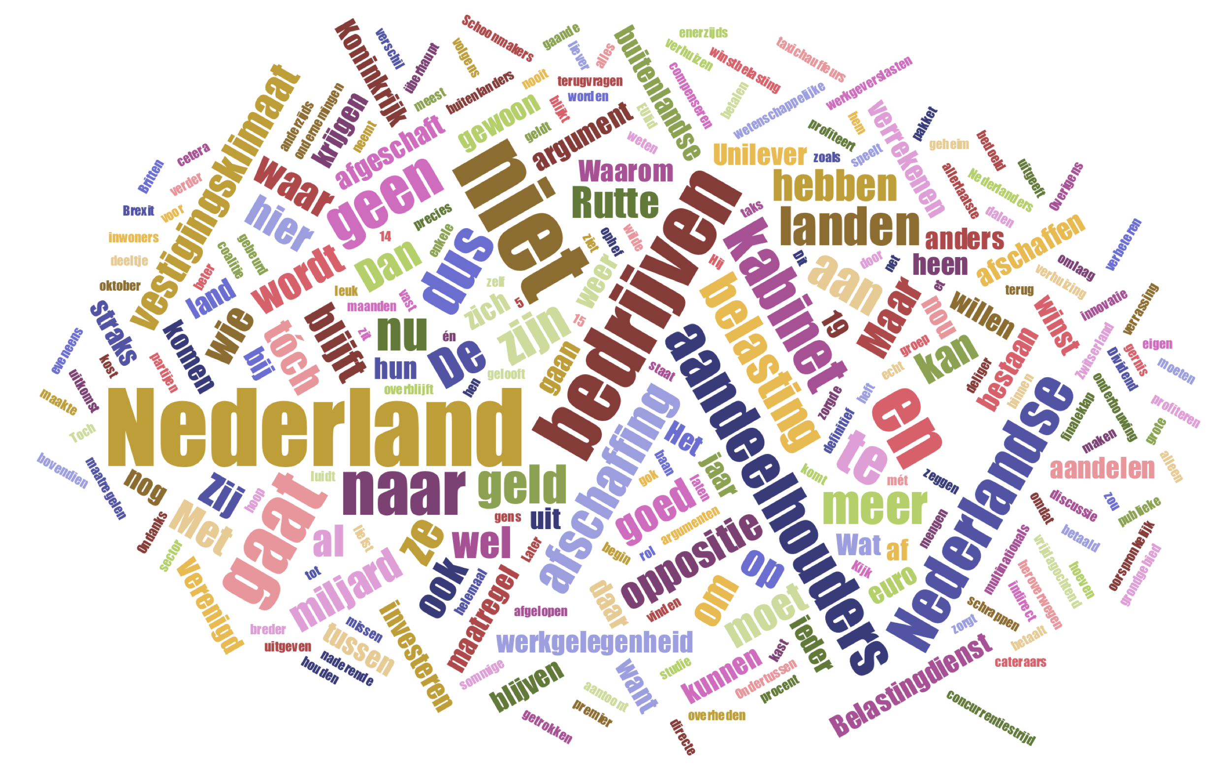

The Dynamics of Mass and Elite in Dutch Dividend Tax Discourse
Rafiazka M. Hilman
Department of Network and Data Science
Central European University

Slide 2
Background
Political sphere in the Netherlands has been passing through torturous way due to the legislation process on Amendment to the Dividend Tax Act 1965 for the last 12 months.
The government proposal on the abolishment of dividend tax (dividendbelasting)
Observations:
> ideological distance among central-right coalition parties
> ideological proximity among opposition parties
> political ambiguity among diverged public perception

Slide 3
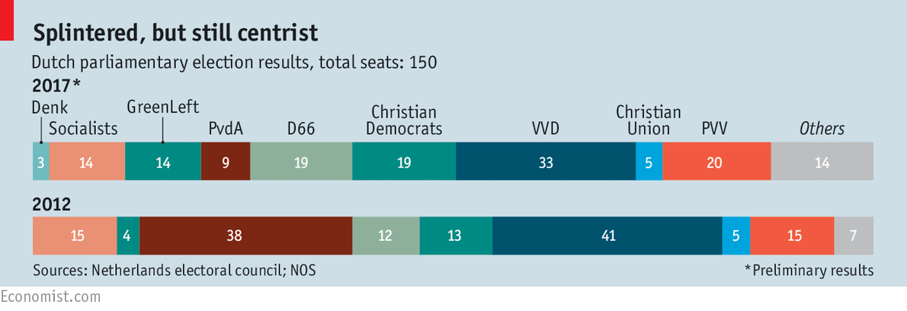
Ideological Spectrum of Political Parties in the Netherlands
General Election Result in 2017
Government Coalition
Source: The Economist (2017)
Source: Krouwel (2017)

Slide 4
Research Question(s)
How does parliamentary debate on dividend tax abolishment portray ideological proximity and ideological distance?
01
How does social network reflect public perception on dividend tax abolishment?
02

Slide 5
Methodology (1)
Data: Kamervragen Tweede Kamer
Keyword: #dividendbelasting
Period: November 2017-October 2018
Language: Dutch
Actor: Coalition and Opposition
” How does parliamentary debate on dividend tax abolishment portray ideological proximity and ideological distance?”

Slide 6
Methodology (1)
List of Key Actors
Party | Name | Twitter
Prime Minister | Mark Rutte | MinPres
PvdA | Asscher, L.F. (Lodewijk) | LodewijkA
FvD | Baudet, Th.H.Ph. (Thierry) | thierrybaudet
VVD | Dijkhoff, K.H.D.M. (Klaas) | dijkhoff
CDA | Haersma Buma, S. (Sybrand) van | sybrandbuma
D66 | A. (Alexander) Pechtold | Apechtold
GL | Klaver, J.F. (Jesse) | jesseklaver
50PLUS | Krol, H.C.M. (Henk) | HenkKrol
DENK | Kuzu, T. (Tunahan) | tunahankuzu
SP | Marijnissen, L.M.C. (Lilian) | MarijnissenL
PvdD | Marianne Thieme (Marianne) | mariannethieme
CU | Segers, G.J.M. (Gert-Jan) | gertjansegers
SGP | Staaij, C.G. (Kees) van der | keesvdstaaij
PVV | Wilders, G. (Geert) | geertwilderspvv

Slide 7
Methodology (2)
Data: Tweet Search API
Keyword: #dividendbelasting
Period: October 2018
Language: Dutch
Actor: Elites, Parties, and Public
”Does public perception on dividend tax abolishment reflect political ambiguity?”

Slide 8
Result and Discussion
Ideological Distance

Slide 9
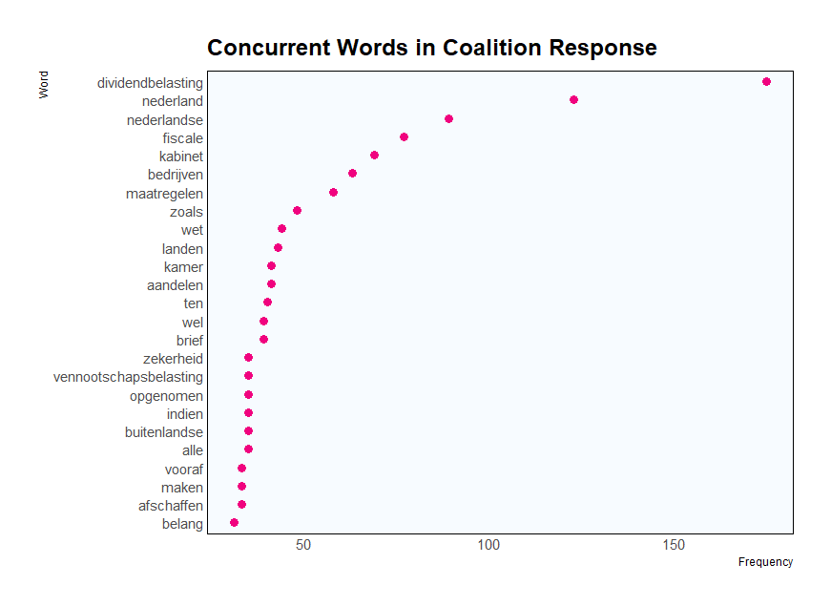
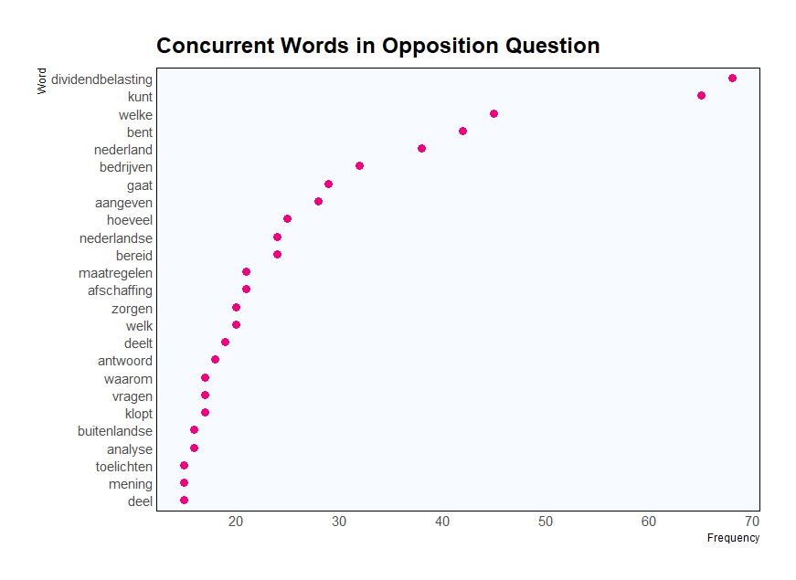
How does each group construct discourse structure?

Slide 10
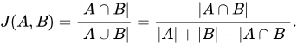
How many attributes in discourse content match?
Jaccard Coefficient
49.9%
attributes in discourse content are shared between opposition and government in parliamentary debate.

Slide 11
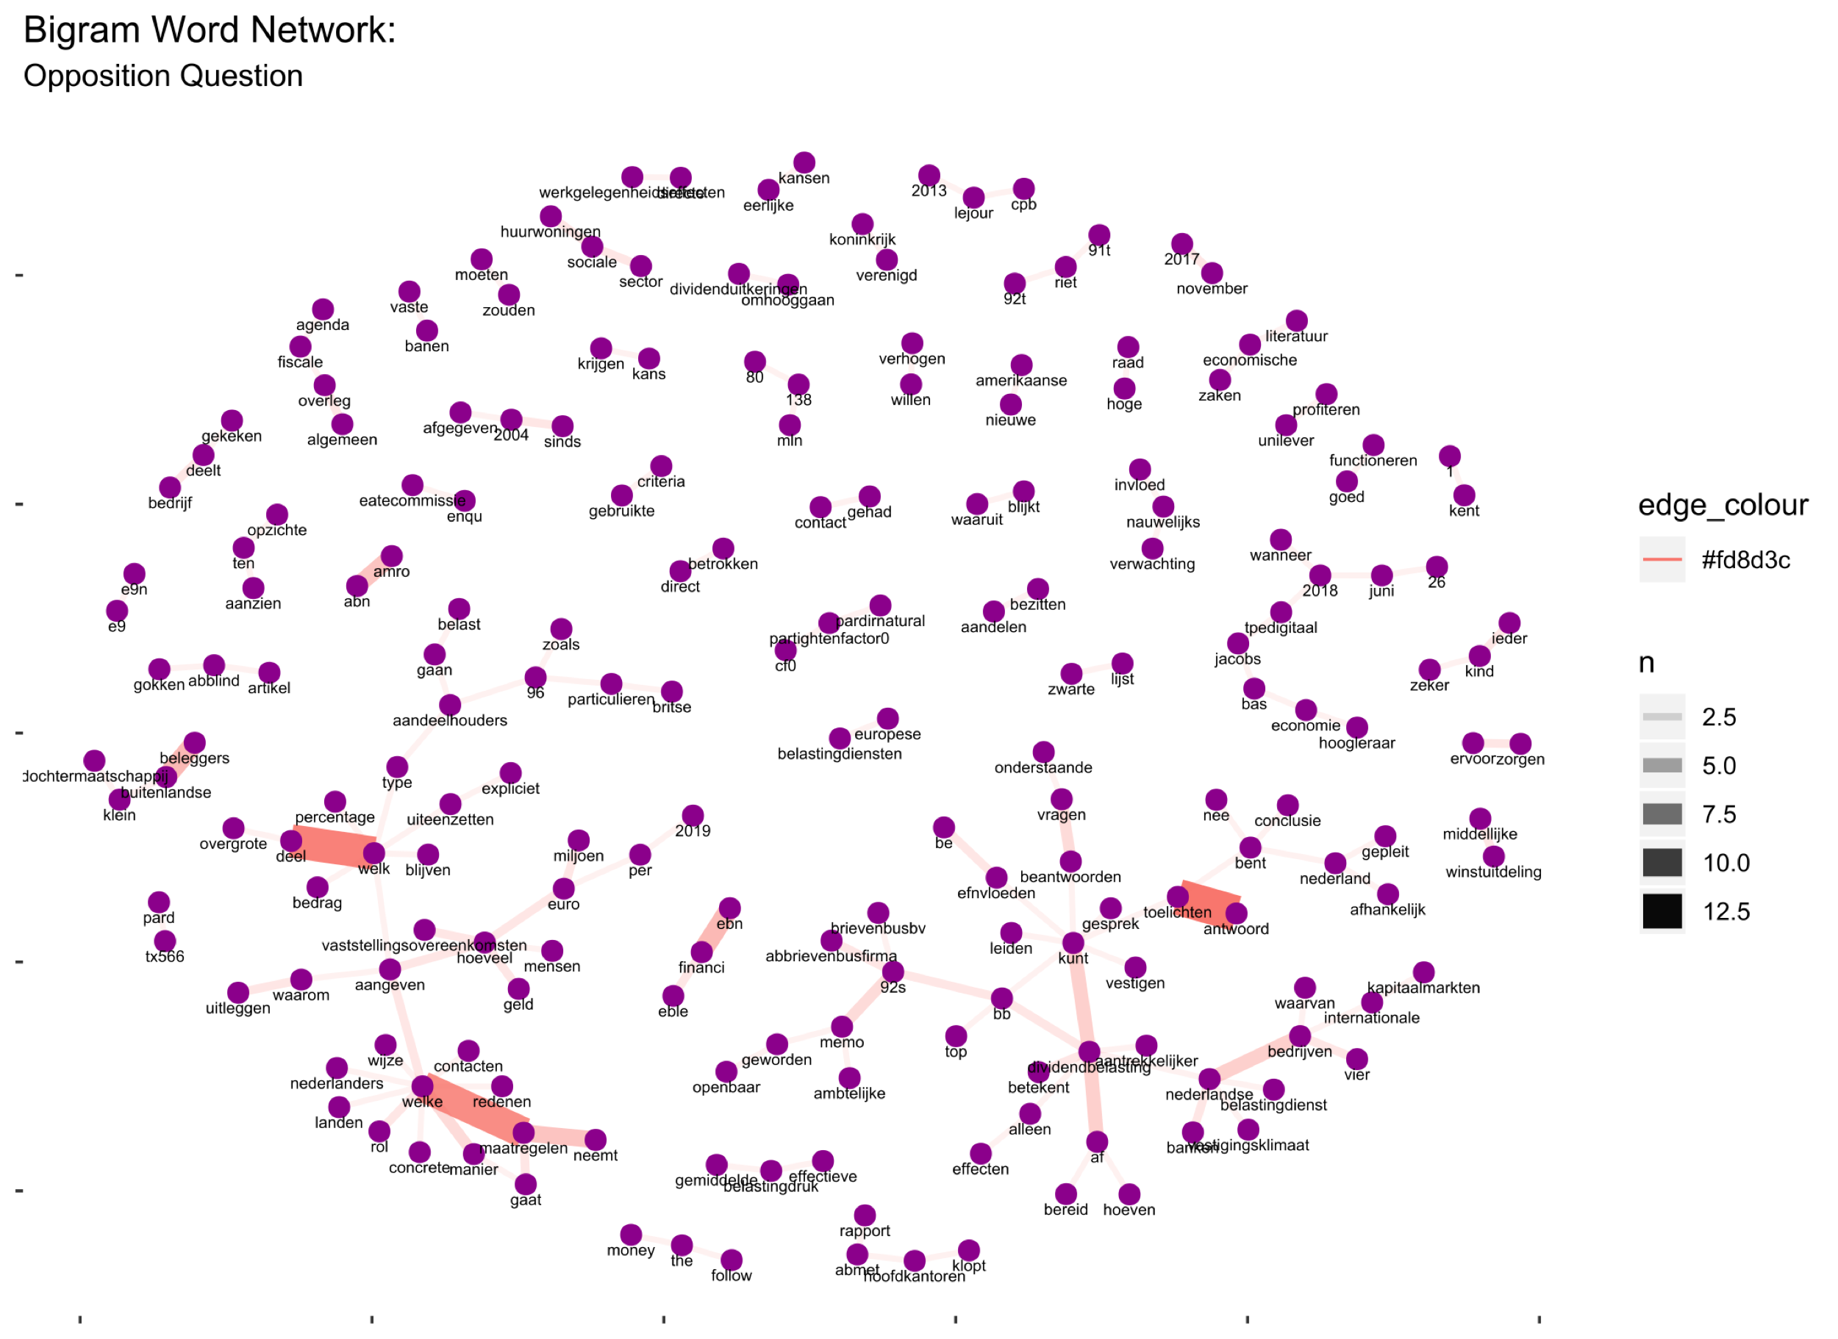
Network graph is used to visualize multiple relationships that exist in the discourse content.
toelichten-antwoord (explain-answer)
welke-maatregelen(which-measures)
maatregelen-neemt(measures-take)
buitelanse-beleggers(foreign-investor

Slide 12
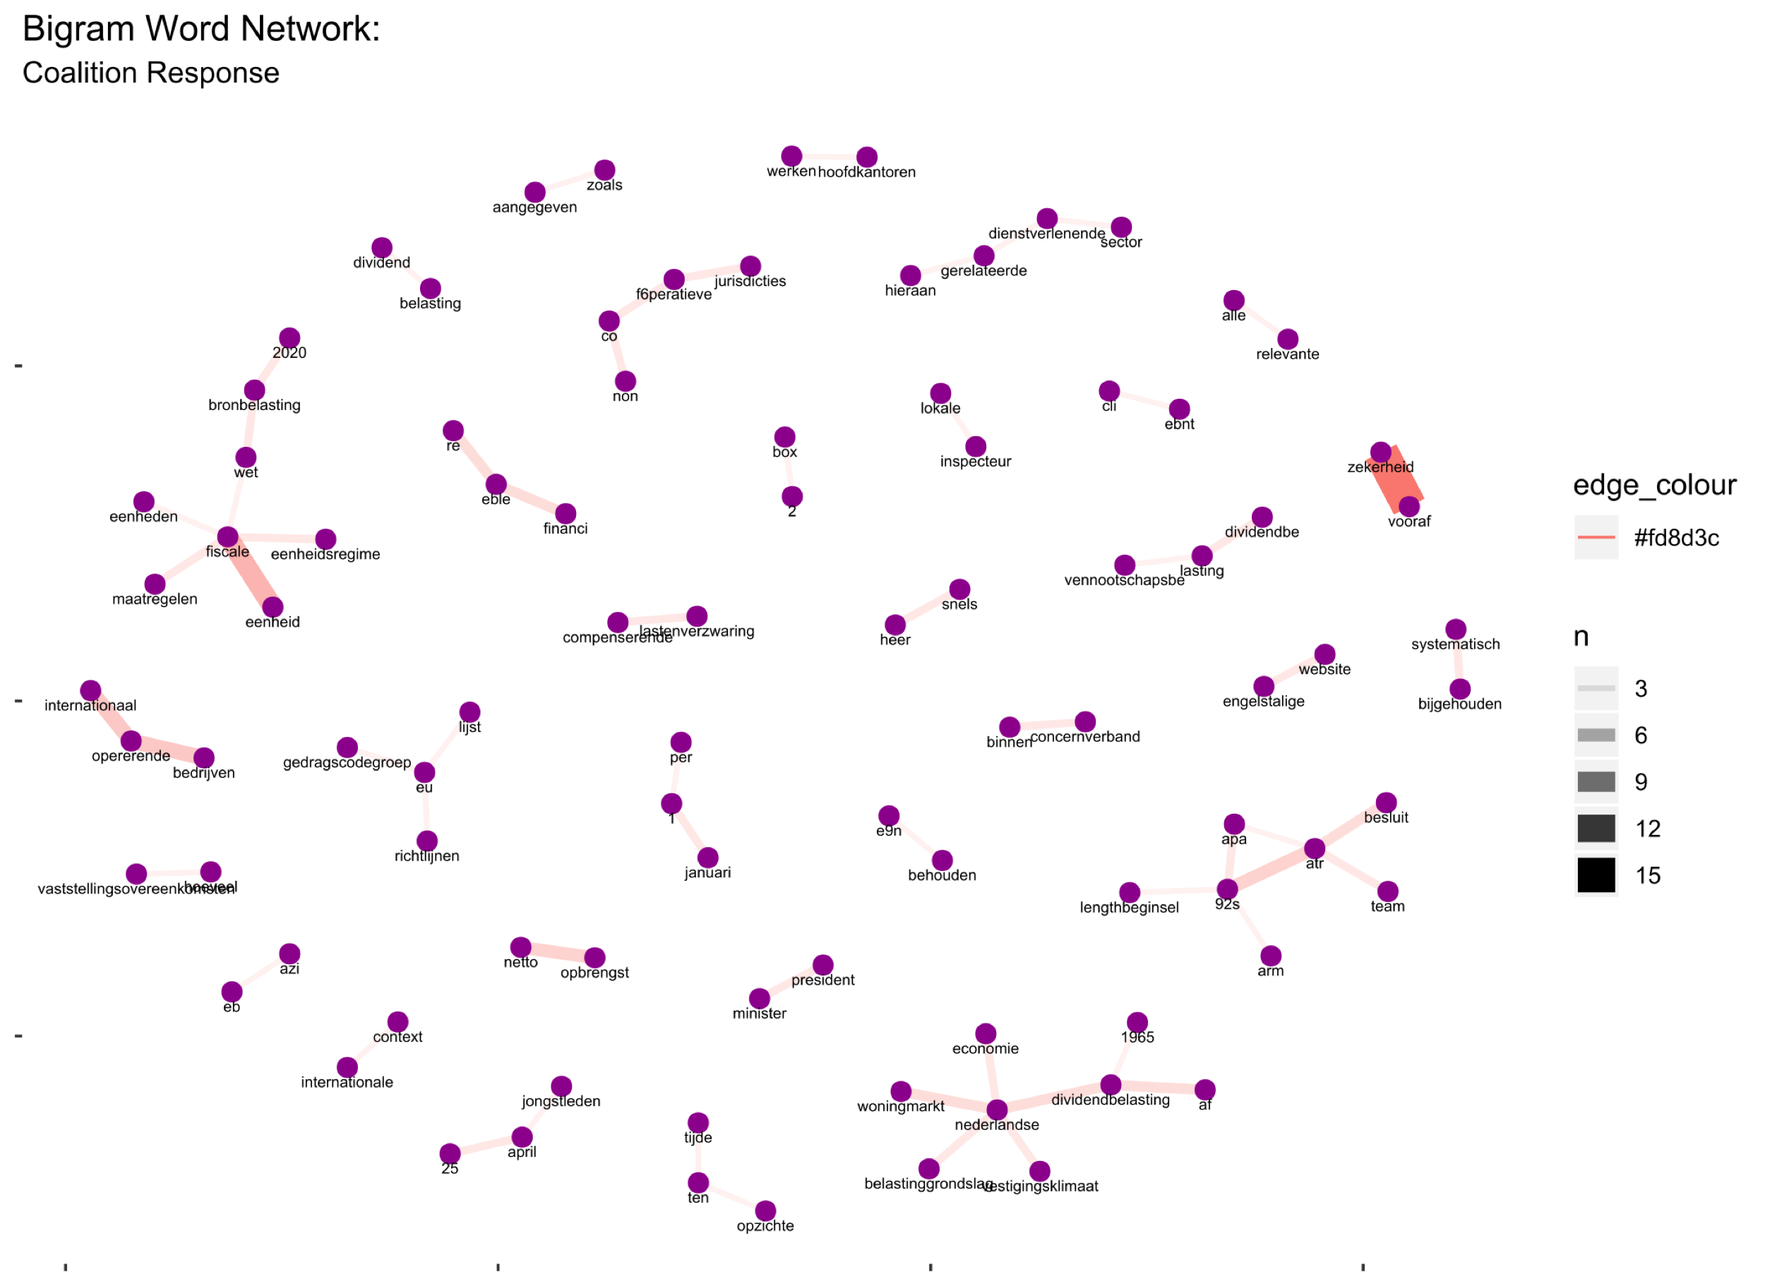
Network graph is used to visualize multiple relationships that exist in the discourse content.
zekerheid-vooraf (certainty-in advance)
fiscale-eenheid(fiscal-unit)
netto-opbrengst(net-gain)
internationaal-opererende(international-operating)
opererende-bedrijven(operating-business)

Slide 13
Result and Discussion
Political Ambiguity

Slide 14
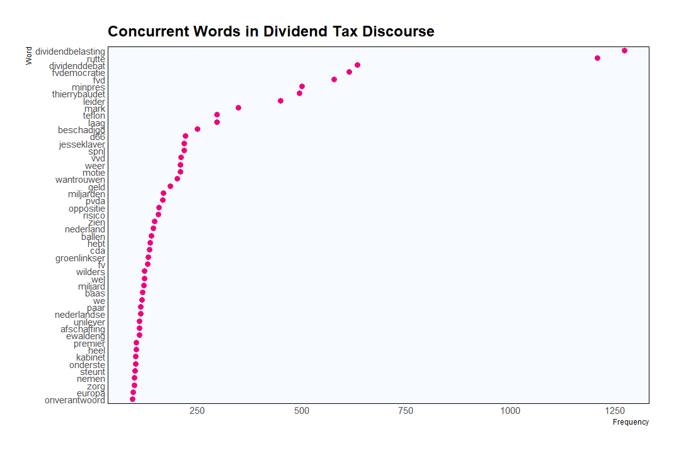
Concurrent Words in Dividend Tax Discourse
Public discourse is closely associated with five features:
Prime minister
Opposition
Coalition
Political dynamics
Policy agenda

Slide 15
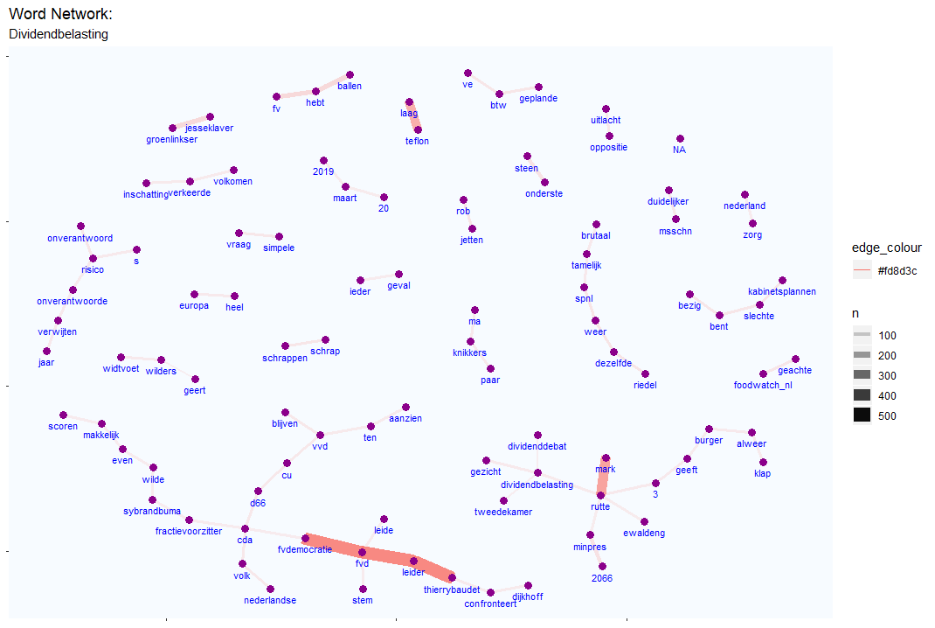
Word Network of Dividend Tax
How words are used one after another to express public perception regarding to dividend tax discourse?

Slide 16
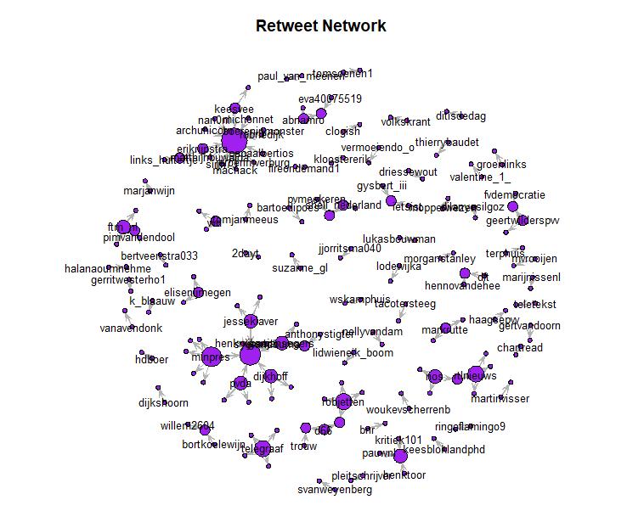
Retweet Network
A directed and weighted network.
Node size → in-degree centrality.

Slide 17
Conclusion
The dividend tax abolishment bill sponsored by the newly elected government of the Netherlands triggers the emergence of public discourse at both elite level and grass root level.
Ideological distance reflects the torturous path towards tax dividend policy consensus between coalition.
Ideological proximity between opposition parties increases in terms of their standpoint against dividend tax abolishment plan.
Political ambiguity arises among grass roots especially on the billion-euro potential loss as a policy cost.
Five features related to public perception: prime minister, coalition parties/elites, opposition parties/elites, political dynamics and policy agenda.

